Slide 1
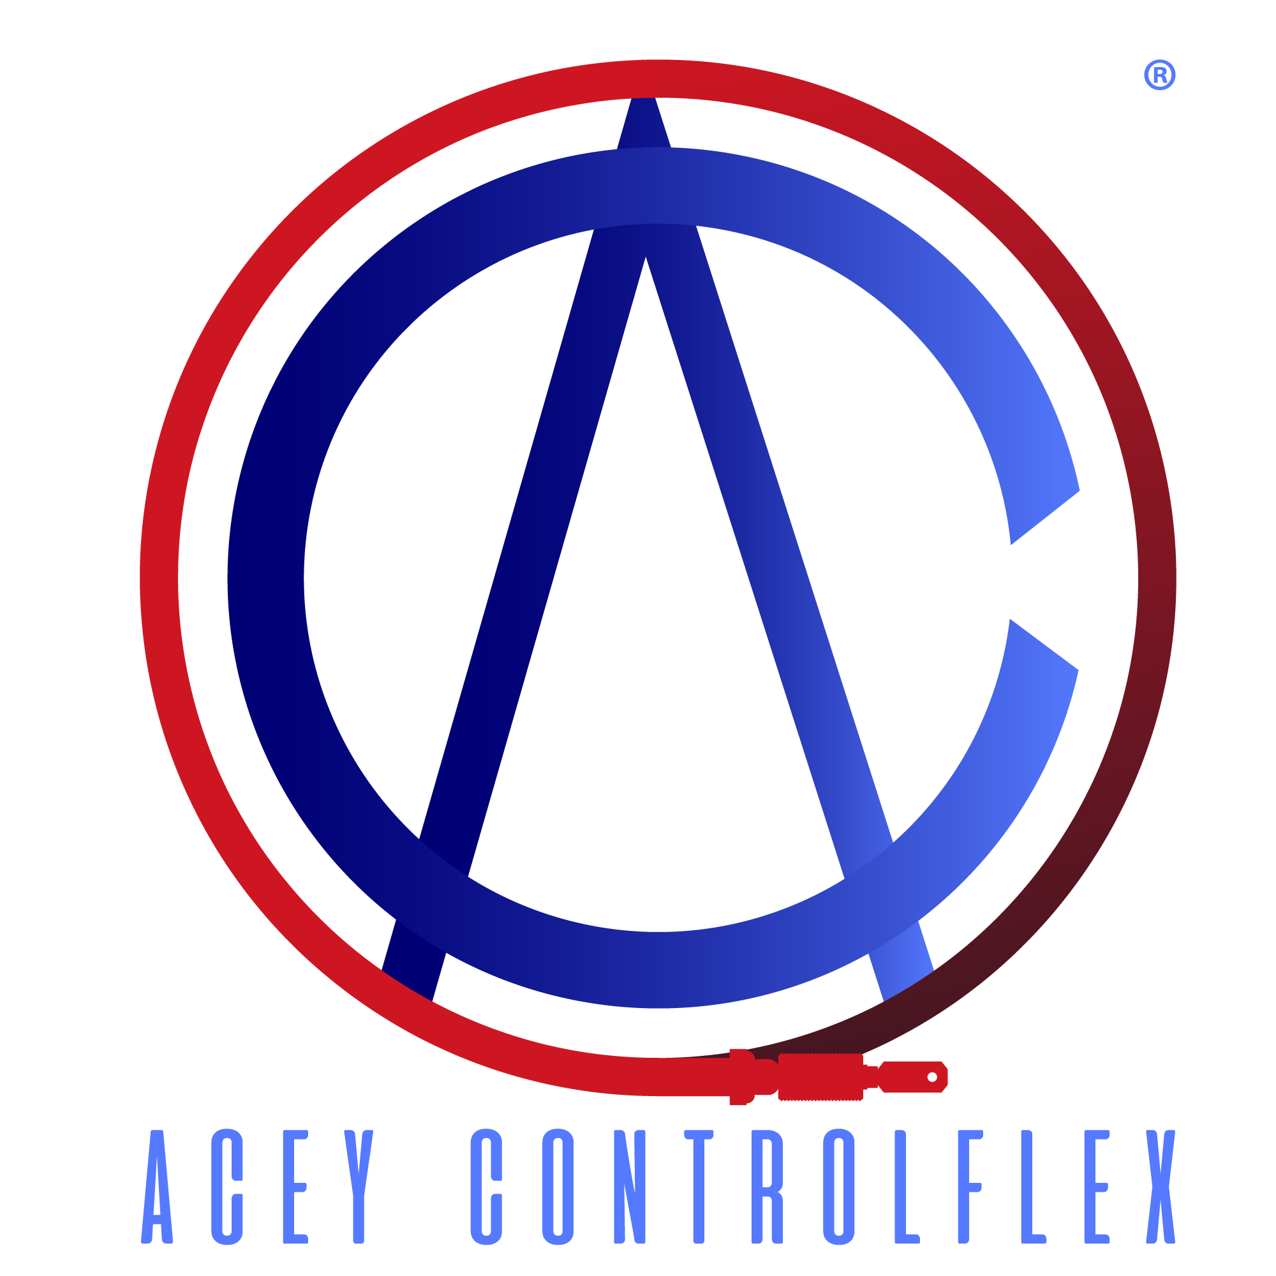

Slide 2
The Joint Venture Story
Our story began in 2023.
Acey Engineering Pvt. Ltd., a leader in manufacturing cables for since 1980, has partnered with Controlflex Group Brazil , a company with over 40 years of expertise in gear shifter cables.
This strategic joint venture combines Acey’s innovative approach in cable technology for small to large vehicles with Controlflex’s specialized experience in gear shifter systems. The partnership aims to leverage both companies' strengths to deliver high-quality, durable and innovative cable solutions in the automotive sector.
Together, they are set to lead in producing cutting-edge cable products for the growing demand in the earth moving , construction equipment's and automotive markets.

Slide 3
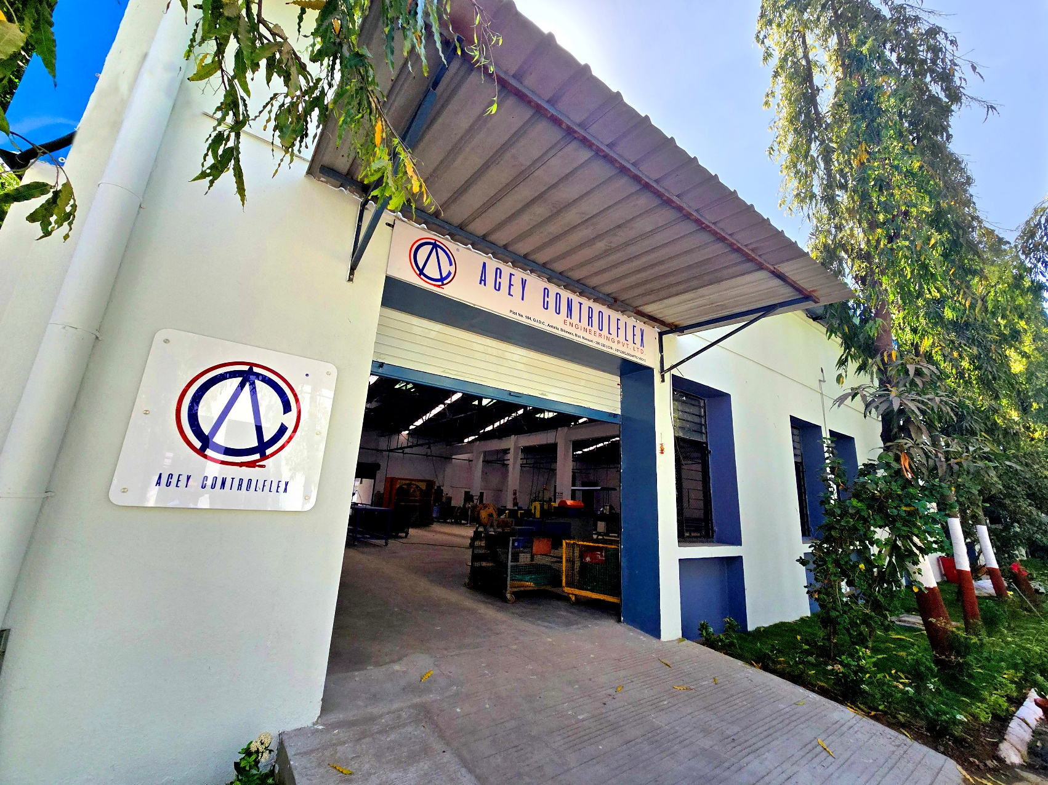
Manufacturing Facilities
Bilimora
South Gujarat, India, which is spread over 8000 Sq.Feet of land.
Bilimora
South Gujarat, India, which is spread over 6300 sq. metres
of land
Pantnagar
Uttarakhand, India, Which is spread over 7000 sq. metres
Of land
Aurangabad
Maharashtra, India, Which is spread over 5200 sq. metres
Of land

Slide 4
Vision & Mission Statement
Vision
We aspire to be the most preferred brand
in the cable industry and achieve a sustainable, competitive share globally whilst implementing socially responsible practices.
Mission
To drive excellence through our products and services by constantly upgrading technology and processes, whereby building long-term relationships with
all our stakeholders.

Slide 5
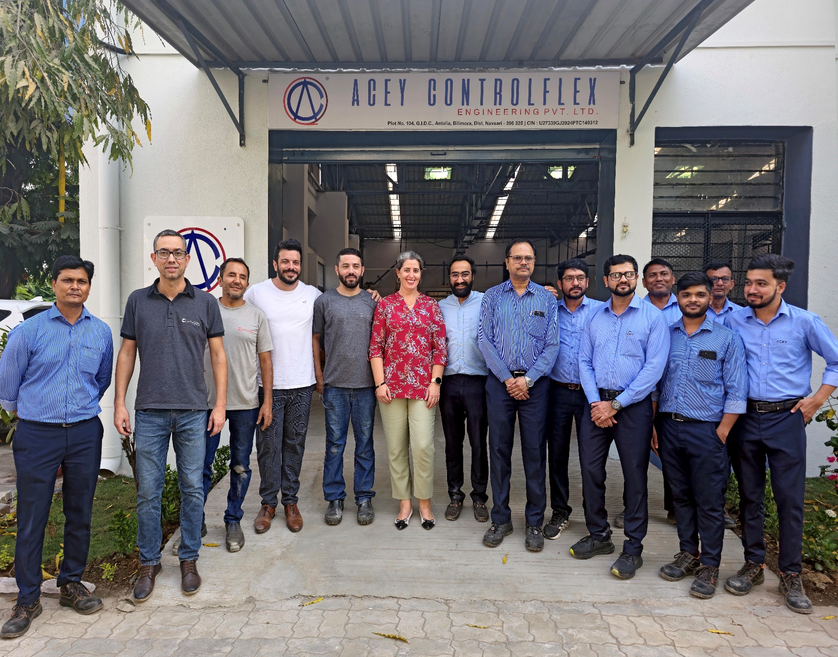
Our Team
Acey Controlflex has a combination of young, enthusiastic and experienced leadership team who sets the strategic direction of our organisation.
Swapnil Chogle
Chief Executive Officer

Slide 6
List Of Manufacturing Equipments
Spiral Winding Machine
24 Wire Planetary Stranding Machine with Spiral Winding Attachment
Outer Coating Extruder With Armouring
Hammer line Armouring Machine
Outer Proof load Testing Machine
Hydraulic Press 63 T ( Swagging )
Inner Proof Load Testing Machine
UTM
Packing Sealing Machine
15 T Hydropneumatic Press
End Of Line Testing
Pneumatic Pipe Cutting machine
Pneumatic Peeling Machine
Air Compressor

Slide 7
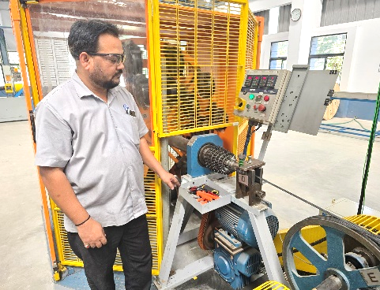
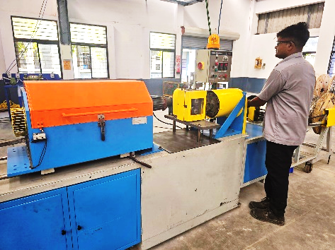
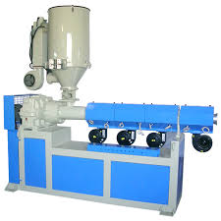
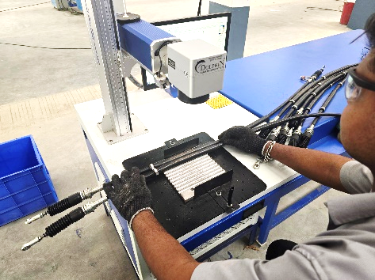
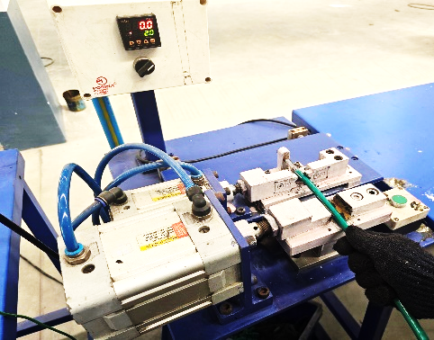
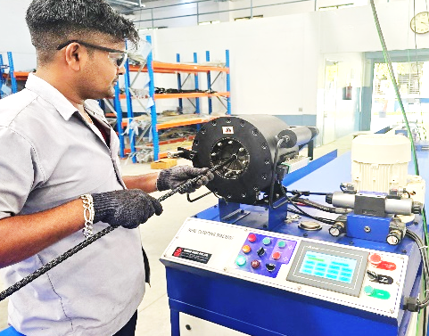
In-House Cable Manufacturing Facilities
In-house design and Manufacturing facility : Acey Controlflex Engineering is having all manufacturing facilities in- house. This gives a better control on Product Quality. We Use advance version of Pro Engineer wildfire 5.0, Pro-E Mechanical, AutoCAD 2010, Catia V5.
24 Wire Planetary Stranding Machine with Spiral Winding Attachment
Hammer Line Armouring Machine
Outer Coating Extruder With Armouring
Laser Printing Machine
Pneumatic Outer Peeling Machine
Hydraulic Press 63 T ( Swagging )

Slide 8
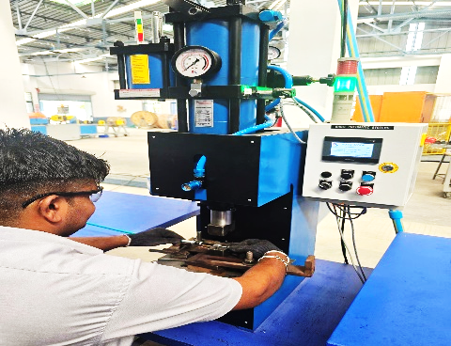
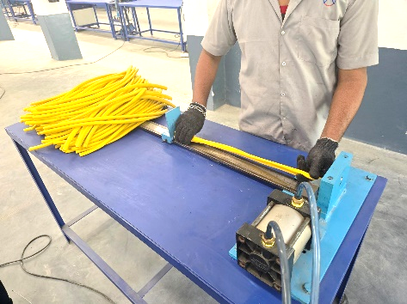
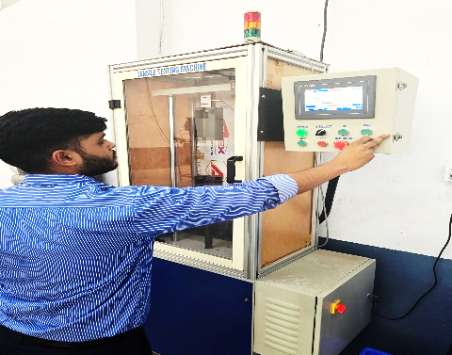
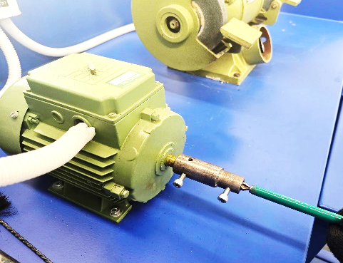
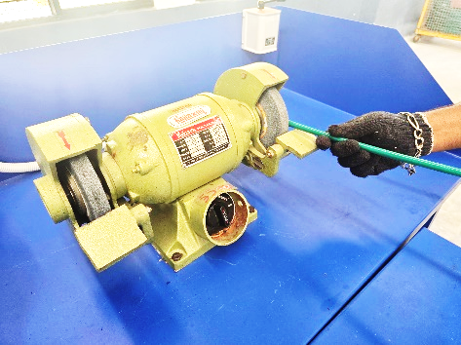
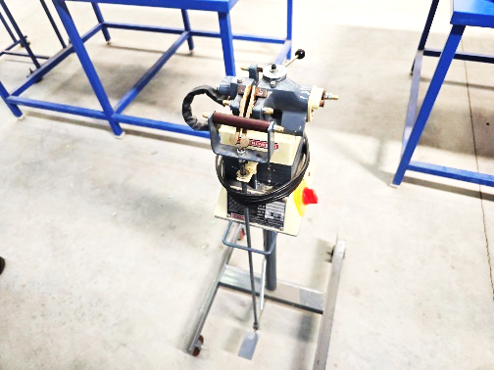
In-House Cable Manufacturing Facilities
15 T Hydro pneumatic Press With Interlocking
Pneumatic Pipe Cutting Machine
Outer Deburring Machine
Outer / Inner Grinding Machine
Butt Welder For Inner
PLC Based UTS Machine

Slide 9
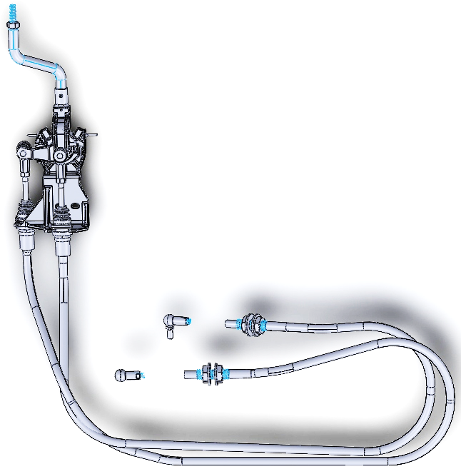
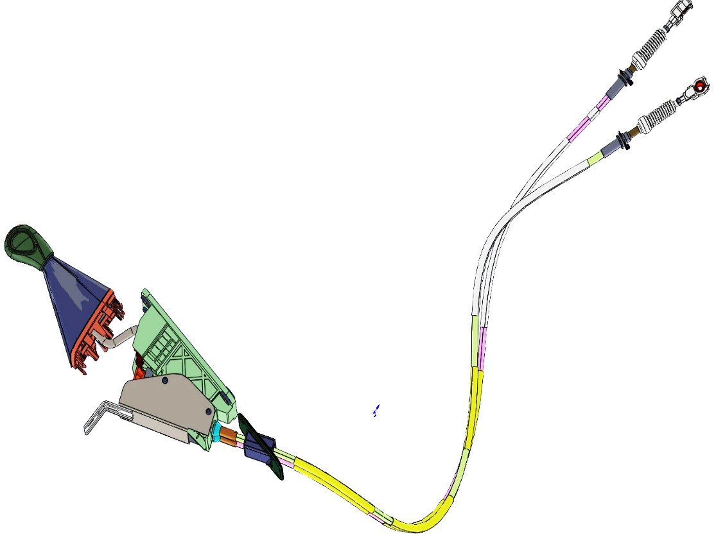
In-House Cable Design Facility
15 T Hydro pneumatic Press With Interlocking
2 D Draft Sight
3 D Solid Works

Slide 10
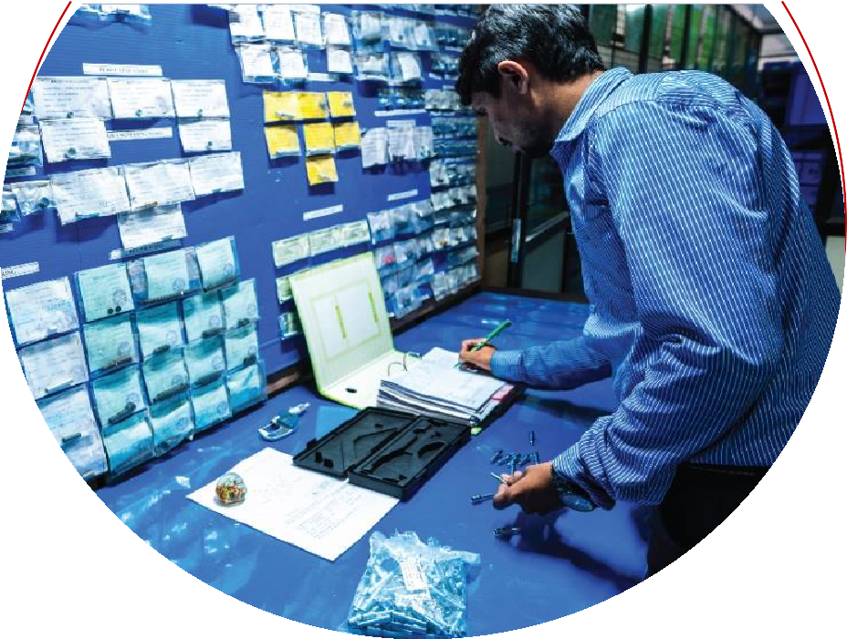
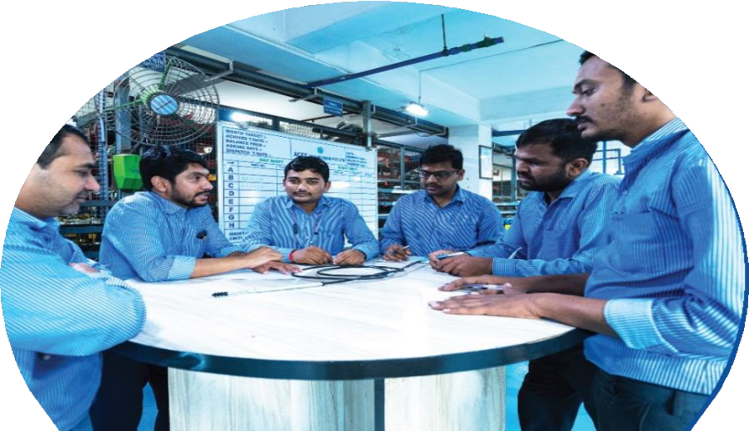
Development & Quality Control
Having a team of Strong Engineers having experience of control cable from past 15 years & Our development team is well-versed with the knowledge of all international standards like DIN (Germany), JASO/JIS (Japan), BS (British), SAE/AISI (American) and ISO (India) or any other requirement that our valued customers should have.
Our Quality Control Department works towards continuous improvements through Quality Circles, Employee Training, Environment Management Systems, Kaizen and Lean Manufacturing so that we continue to manufacture world- class parts which exceed customer expectations.

Slide 11
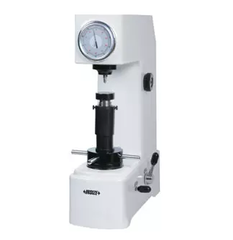
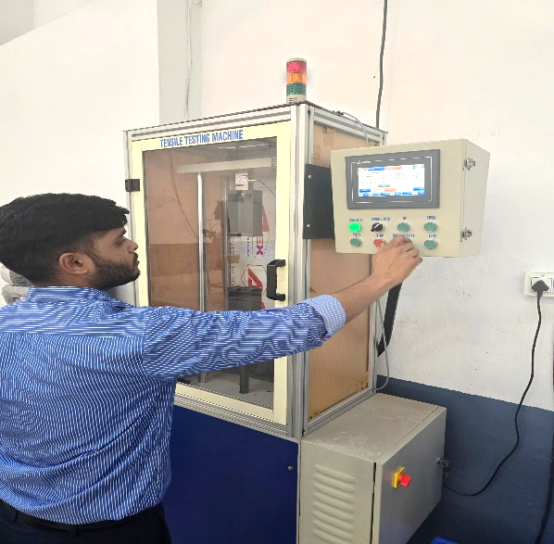
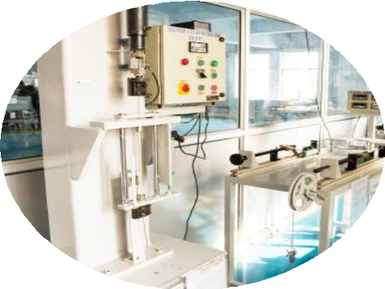
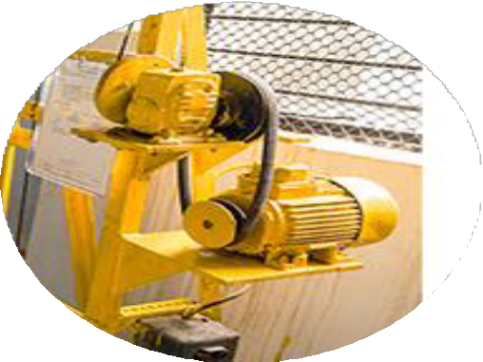
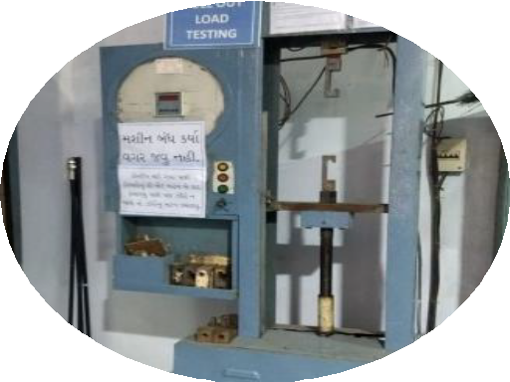
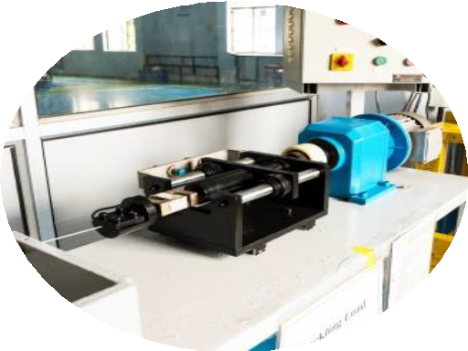
Our products undergo stringent quality tests at all stages of manufacturing in our independent testing facilities. Our trained team of engineers persistently conduct checks and inspection to achieve zero-defects for 100% client satisfaction.
Testing Facilities
Aided by world-class testing equipment, tests under different temperatures and conditions are
conducted to drive excellence through all our products.
Digital Universal
Tensile Testing Machine
Crushing Load Testing Rig.
Buckling Load Testing Rig.
Rockwell hardness Testing machine

Slide 12
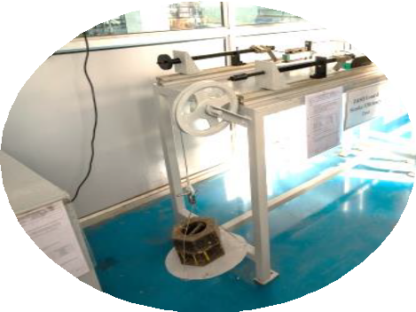
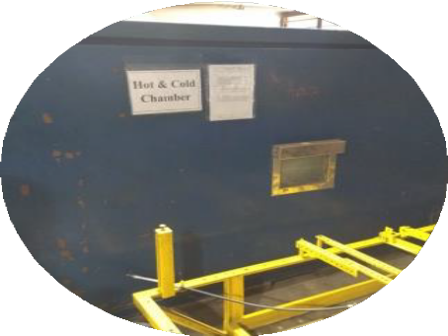
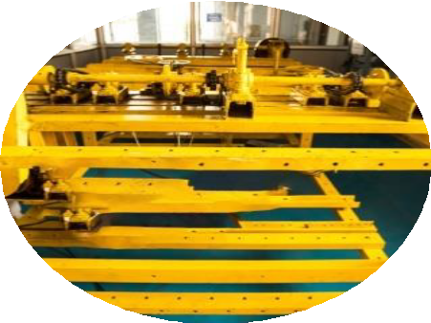
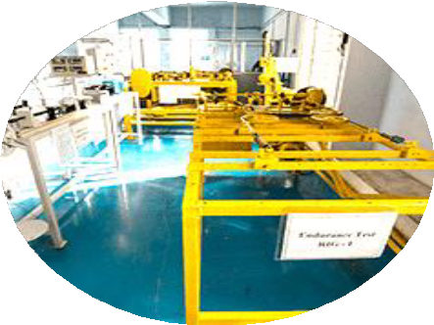
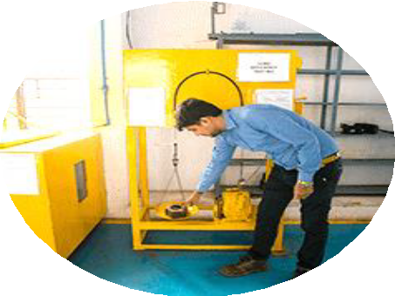
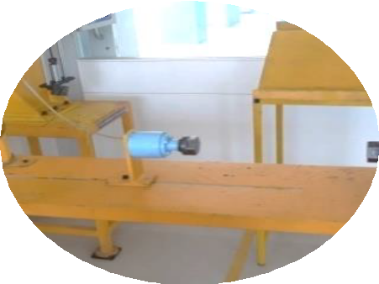
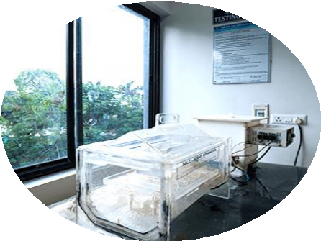
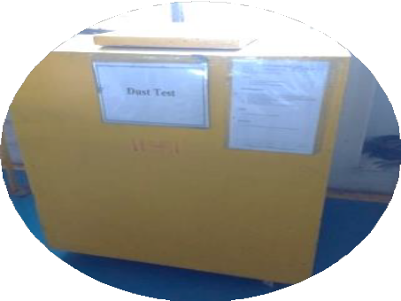
Endurance Test Machines for Product Validation.
Load/stroke Efficiency Testing Rig.
Environmental Hot & Cold Chamber
Endurance Testing Rig As Per Ais067f
Multiple Endurance Endurance Testing Rig
Proof Load Testing On All Lines
Inner Torsional Load Testing
Salt Spray Testing Machine
Dust Test Chambers

Slide 13
Types Of Outer Casing For Push Pull Cables
Bilimora
South Gujarat, India, which is spread over 6300 sq. metres
of land
Pantnagar
Uttarakhand, India, Which is spread over 7000 sq. metres
Of land
Aurangabad
Maharashtra, India, Which is spread over 5200 sq. metres
Of land

Slide 14
Types Of Outer Casing For Push Pull Cables
Bilimora
South Gujarat, India, which is spread over 6300 sq. metres
of land
Pantnagar
Uttarakhand, India, Which is spread over 7000 sq. metres
Of land
Aurangabad
Maharashtra, India, Which is spread over 5200 sq. metres
Of land

Slide 15
Types Of Outer Casing For Push Pull Cables
Bilimora
South Gujarat, India, which is spread over 6300 sq. metres
of land
Pantnagar
Uttarakhand, India, Which is spread over 7000 sq. metres
Of land
Aurangabad
Maharashtra, India, Which is spread over 5200 sq. metres
Of land

Slide 16
TYPES OF INNER CABLE

Slide 17
TYPES OF INNER CABLE

Slide 18
Gear Shifter Cable Applications
Sr No | Type Of Vehicles
1 | Earth Moving Equipments
2 | Marine (Cruiser & Ships)
3 | LCV, MCV
4 | Trucks
5 | 4 Wheeler
6 | 3 Wheeler
7 | Tractors

Slide 19
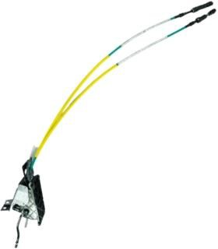
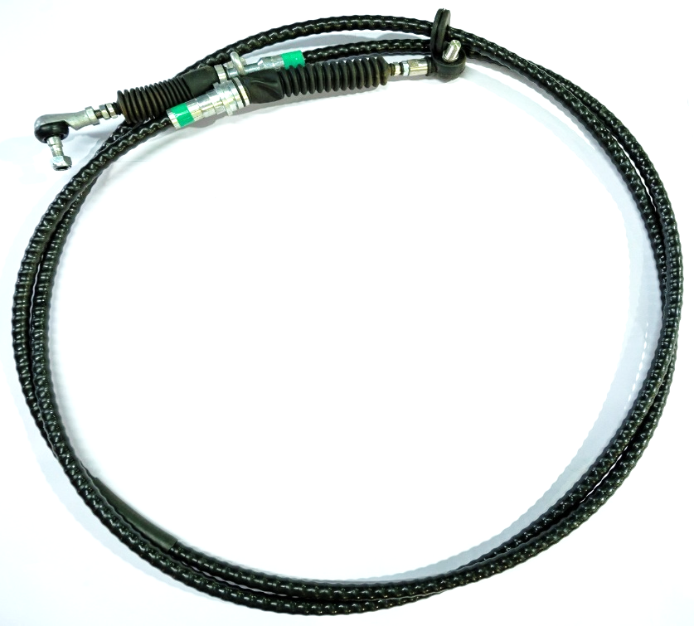
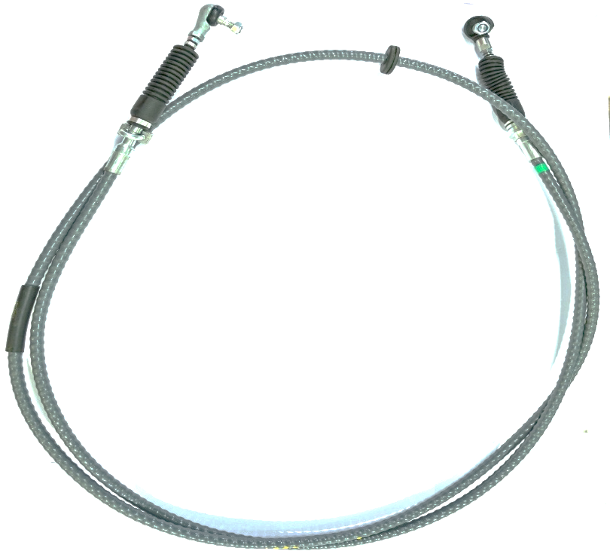
OUR PRODUCTS (FOR LCV/MCV/HCV/CE)
Gear Shifter Assy With Lever
Gear Shift Cable
Gear Select Cable

Slide 20
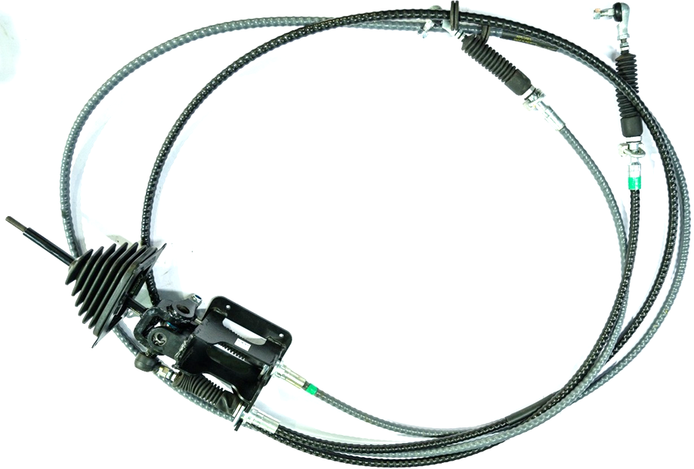
OUR PRODUCTS (FOR LCV/MCV/HCV/CE)
Gear Shifter Assembly with Mechanism – Heavy Duty

Slide 21
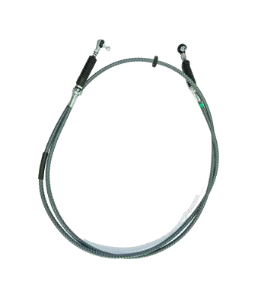
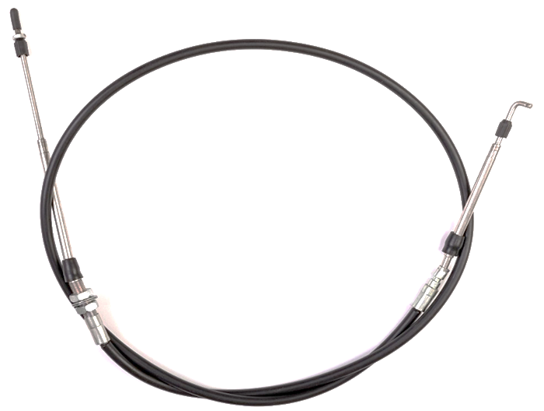
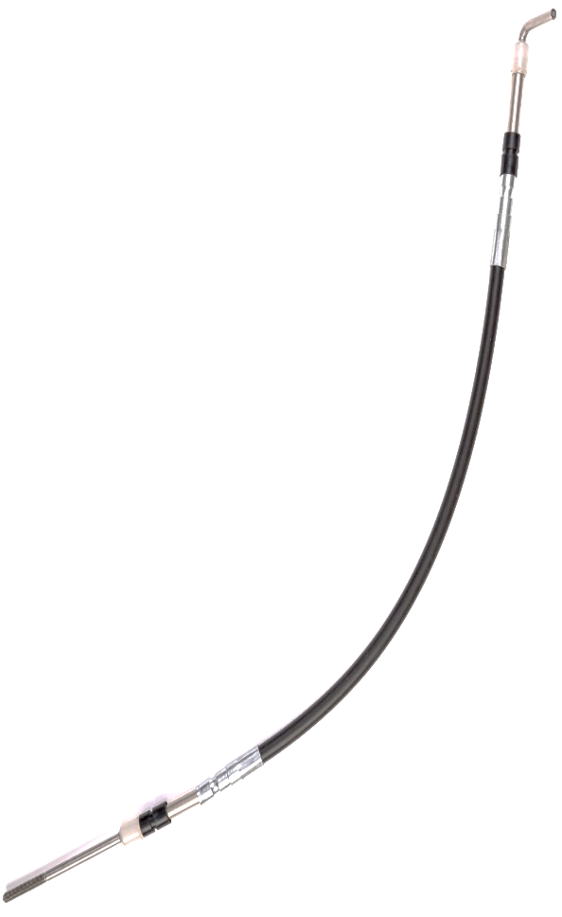
OUR PRODUCTS
(FOR PASSENGER VEHICLES)
GEAR CABLE
PUSH PULL CABLE
TRANSMISSION CABLE

Slide 22
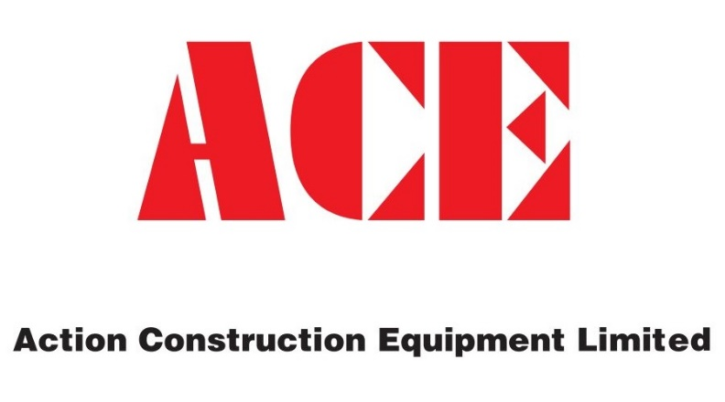
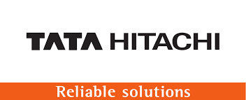
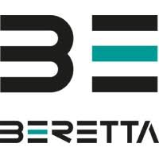
Our Valued Customers for Gear Shifters

Slide 23
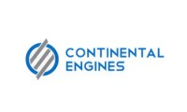
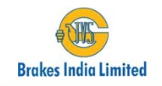
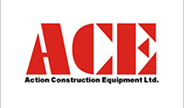
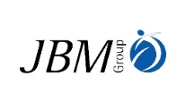
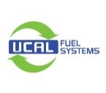
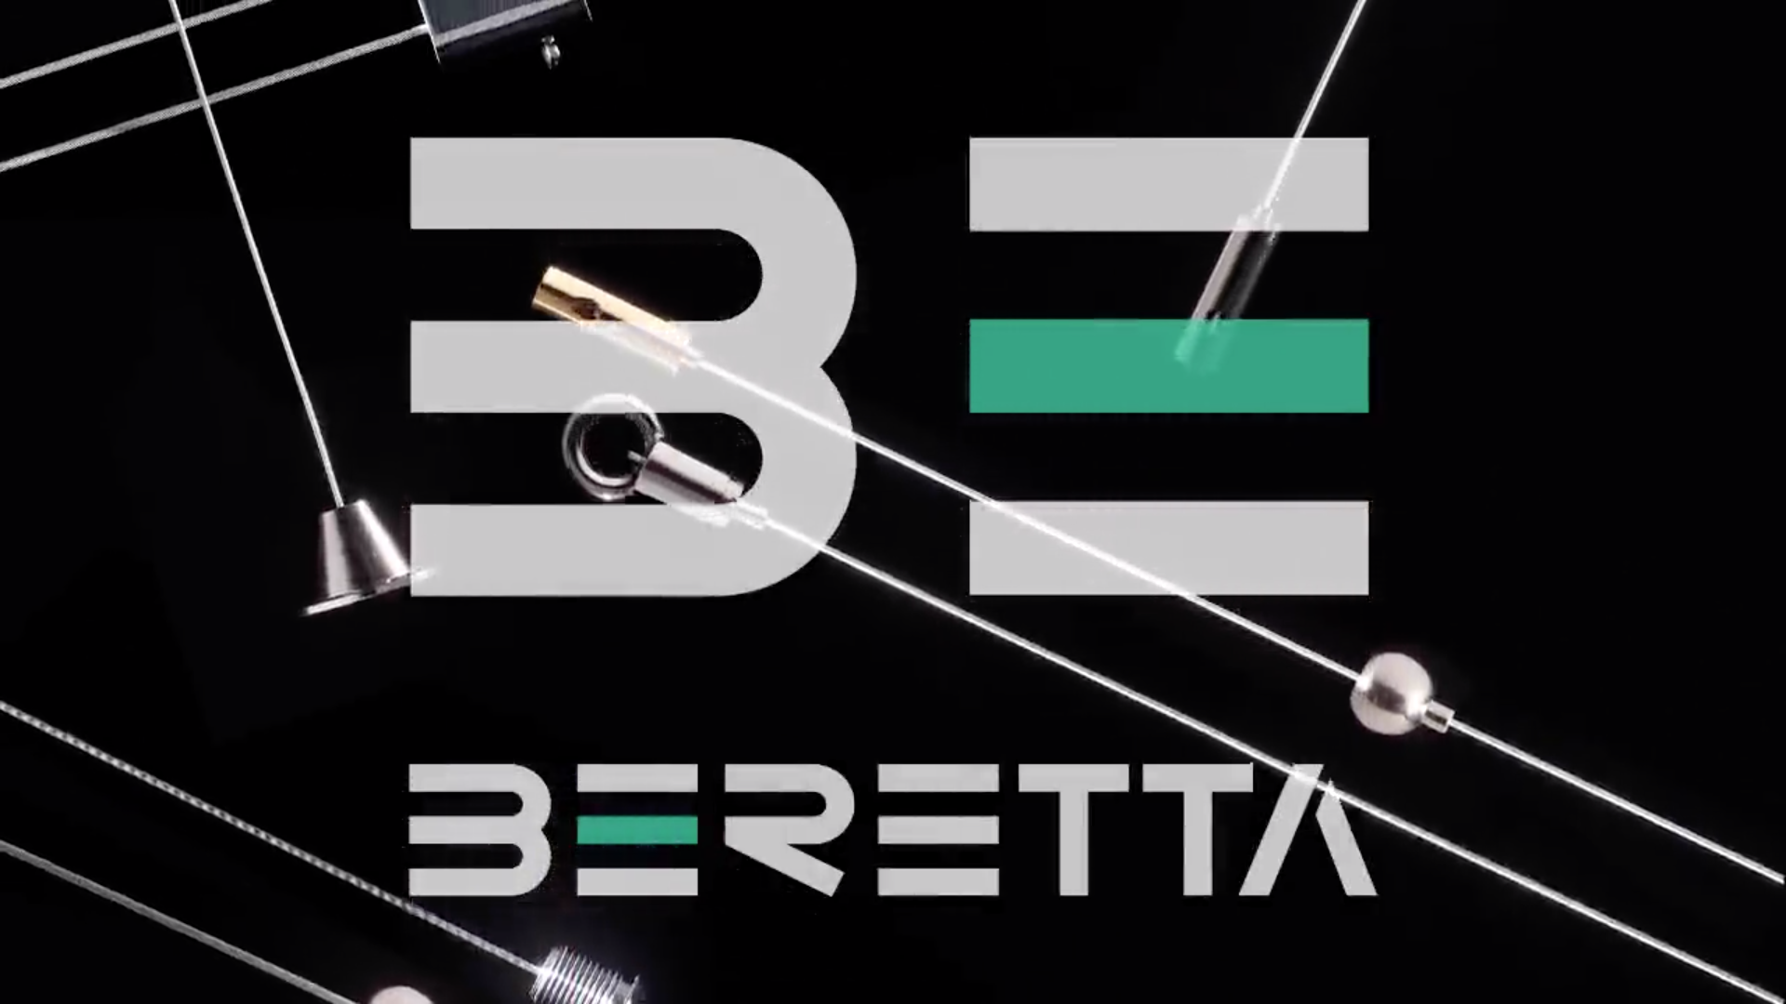
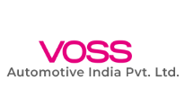
Acey’s CUSTOMER Portfolio

Slide 24
Controlflex CUSTOMER Portfolio

Slide 25
Sectors
Automotive segments that include Three wheelers , Four wheelers both Passenger & Commercial Vehicles ( LCV / HCV ) sector.

Slide 26
Non-Automotive sectors that include Railways, Earth Moving Equipment, Marine, Electrical and Agriculture, to name a few.

Slide 27
T H A N K Y O U…

